Slide 1
Data Mining Cup 2017 Revenue Forecast of Mail Order Pharmacy
Final presentation
Data and Web Science Group
University of Mannheim
Alexander Brinkmann, Liane Gybas, Daniel Helfer, Nancy Kunath, Florian Schrage, Timo Sturm, Steffen Terheiden, Christoph Wagner
23.05.2017

Slide 2

Overview
Selection
Preprocessing
Transformation
Data Mining
Evaluation & Interpretation
Available data
…….
Target
Data
Preprocessed Data
Transformed Data
Patterns
Adopted from Fayyad et al. (1996)

Slide 3
Preprocessing Features
Development of Features
Use of Features
95 features based on transformation, combination, interpretation and on influence of external information.
biggest performance improvement: Basket features (id, price, size)
Reduce set with weight of GTB from 111 to 44
Main information used
Basket (#4)
Day related (#5)
Week related (#3)
Price (#17)
Order (#2)
Others (#13)
# 111 Features
# 44 Features

Slide 4
Preprocessing Examples
TIMO & Co: Replace this slide with other major steps in preprocessing???
Train Dataset
Training Days 22 – 63 (Sunday to Saturday, cut after the court judgement on day 19 Oct.)
Evaluation Days 64 – 93 (Sunday to ….)
Class Dataset
Task Days 94 – 123 (Sunday to…)

Slide 5
Transformation, Data Mining and Evaluation
Selection
Preprocessing
Transformation
Data Mining
Evaluation & Interpretation
Available data
…….
Target
Data
Preprocessed Data
Transformed Data
Patterns
Adopted from Fayyad et al. (1996)

Slide 6
Different approaches
Original task
Two step model
Partial two step model
One step model
Predict order
(Orders with Classification)
Predict order
Predict revenue with an improved regression learner
By predicting revenue directly or
Predicting quantity and calculate revenue
Predict the revenue for every user action
Select only highly confident values
Predict the revenue for all “order” actions
with regression
Predict the revenue for all “order” actions
Regression problem
Classification problem

Slide 7

Transformation, Data Mining and Evaluation
Baseline: RMSE = 10.238 (and GBT: 9.679)
Competing approaches:
Part. Two-Step: RMSE = 9.218
One-Step: RMSE = 9.161
* http://unisci24.com/178087.html

Slide 8
Two-Step – Regression
What we have tried RMSE
Regression with 75% accuracy in prior classification XXXX
Potential result: Regression with „order=1“ 4.797
100% accuracy,
hence a perfect classification would lead to a very
big baseline improvement
Two-step Regression with 82% accuracy due to XXXX classification improvements
Partial two-step Regr. (high confidence values only) 9.218 with 95% accuracy

Slide 9
Two-Step – Prior Classification
What we have tried Accuracy
Classification Baseline with Naive Bayes 75%
Using all classification algorithms and an ~80% evolutionary feature selection
Best: Naive Bayes, Neural Nets, GBT
Trying different ensemble methods 82%
Best: Voting
Using confidence scores to generate an example 95% subset with higher accuracy
Notes:
Tonspur !!!!! Compromised all algorithms local runtime and performance !!!!

Slide 10
One-Step – Regression
What we have tried RMSE
Baseline Regression with „Default model“ 10.306
Regression with quantity labeling, best result: 9.361
In direct comparison predicting quantity and calculating revenue with the given price attribute always performed worse than predicting revenue directly
Rounding the quantity to integer values did not improve results
Regression with revenue labeling, best result 9.161
Including attribute selection with GBT „weight vector“
Improving the parameters of GBT: 35 Trees with a depth of 7

Slide 11
One-Step – Regression
What we have tried and didn‘t RMSE improve the result
Trying other regression algorithms: no improvement
i.e. Linear regression, Polynominal regression and Local Polynominal regression
Clearly the best: Gradient Boosted Trees
Splitting according to different attribute values: no improvement
Sales index for quantity regression
Basket size for revenue regression
Sliding window evaluation (w/o Basket attributes) 9.701
Day vs Week
Cumulated vs non-Cumulated
Notes:
Tonespur !!! Different algorithmy to discribing differnt patterns of the data !!!

Slide 12
Not Finished Approaches
Frequent Item Set Generation
Based on Generated Baskets
Extraction of Frequent Item Sets of Ordered and Non-Ordered Baskets
Backchecking on whole training set for distribution of Order and Non-Order Transactions per Frequent Item Set
Keeping Frequent Item Sets with Confidence above 85% for bypassing the classification of the whole basket and generation of features
Basket Order Prediction
Create Training Data → Ordered baskets + All other possible baskets
Aggregate features on basket level (unit, pharmForm, etc.)
First trained GBT without further improvements:
Ordered Baskets Recall: 49.45% / Precision: 15.93%
Ordered Transactions Recall: 75.53% / Precision: 37.02%

Slide 13
Summary and Lessons learned
Revenue vs. Quantity
Revenue performs better
The deviation per item has less impact.
One-step vs. two-step
Regression only (One-Step) performs better
No reach of 100% accuracy of two-step, hence increased error deviation in subsequent step
Other insights
Iterative Project Approach helpful
Further exploition of sequential patters in data
Mining Environment extended to Python & R
Results of Association Analysis not used
Collaboration: Trello, Googledrive and Github

Slide 14
Questions?
Feel free to ask!

Slide 15
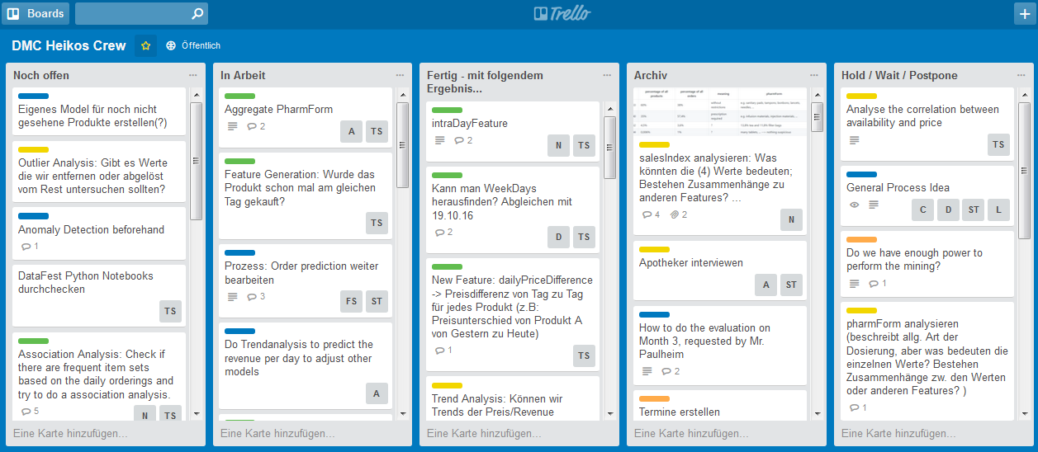
Backup Slides – Trello Board

Slide 16
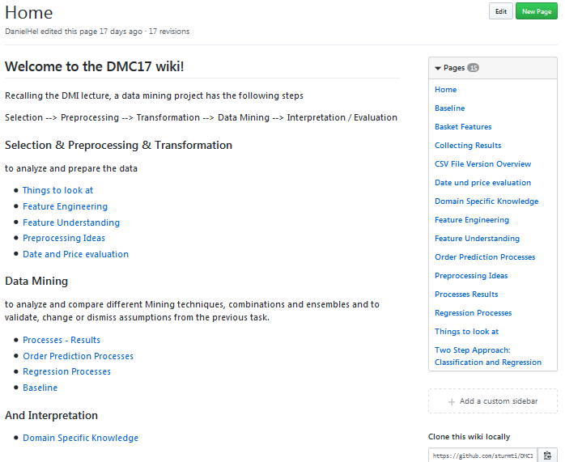
Backup Slides – Github

Slide 17
Backup Slides – 44 Features
Basket_Size
rrp
productOrderRatio
manufacturer
price
group
DayTime
BasketPrice
basket_id
diff_rrp_price
basket_position
pharmForm
DayID
competitorPrice
weekday_name
priceNorm
weekday_number
priceCategory
differenceDailyPriceDifferenceCompetitorPriceDifference
Week
variance(price)
ratio_diff_rrp_competitorPrice_to_rrp
lineIDPerDay
day
priceMeanPriceVariance
diffPriceCompetitorPrice
dailyCompetitorPriceDifference
dailyPriceChange
dailyPriceDifference
ratioDiffPriceCompetitorPriceToPrice
ProductManufacturerRevenueRatio
GroupSizeSameProductAttributes
ratio_diff_rrp_price_to_rrp
quantityByPackage
ProductManufacturerOrderRatio
productOrderCounter
ratioDiffPriceCompetitorPriceToCompetitorPrice
productActionCounter
SameProductAttributes
pid
pharmFormGroup
dailyPriceFlexibility

Slide 18
Feature Understanding and Engineering
Preprocessing – Feature Understanding/Engineering
On hold
Summary about our feature understanding steps:
analysed for missing values – e.g. competitorPrice
searched for outliers
Releted to specific field how: „pharmForm“ with 278 in 3-digit strings.
We interviewed a pharmacist, so we understand the policy of dosage codes and acronyms how e.g. „NTR“ = „Nasentropfen“
Sales index that was descriped in dispensing regulation codes
We analysied the correlation between the given attributes
Also we find out that 82 products were „always“ bougth.
In the other way we saw that 3100 products were never bought
And the import step for the dataset split after the 22nd day
Notes:
Outlier – 0 too low

Slide 19
Feature Understanding and Engineering
After analyzing the number of order, basket and click transactions, we discovered
that during the first 22 days of our training set the number of click transactions
was noticeably lower than during the following days.
Reasons for that may be for example different data creation processes. We decided to exclude these 22 days
Judgment of the Court (First Chamber - EuGH) of 19 October 2016:
Deutsche Parkinson Vereinigung eV vs Zentrale zur Bekämpfung unlauteren Wettbewerbs eV Setting of fixed prices for medicine, which are only available on prescription, is against European Law
Notes:
Outlier – 0 too low

Slide 20
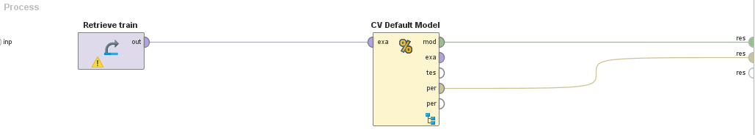
Transformation, Data Mining and Evaluation
Baseline
Performance of the Default Model
With defauft model: Average: RMSE = 10.238
For comparison, basic Gradient Boosted Tree: RMSE = 9.679
*RMSE : Root Mean Squared Error
Notes:
Informations for the baseline

Slide 21
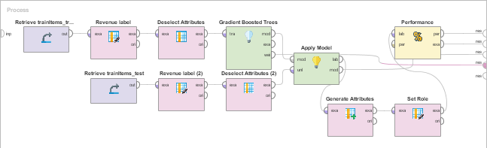
Approache – One-Step
One-Step
Performance of the Default Model
Median: RMSE* = 9.161 by using GTB (Gradient Boosted Trees)
*RMSE : Root Mean Squared Error
Notes:
Informations for the baseline

Slide 22
Feature Understanding and Engineering
Preprocessing – Feature Understanding/Engineering
on hold
Mainly created with R and Python
in whole our final dataset holds 111 features
95 features based on transformation, combination, interpretation and with influence of external informations.
use only16 start initial features in the final approache = RMSE 9.747
After analyises with weight of GTB we reduced the final set to 44 features.
One of biggest performance improvement: we created a Basket feature based on groupig multiple user transactions.
With this feature Summary about our feature engineering steps:
it was possible to say if the basket was orderd or not
Highly imbalance training data: Recall 49.45% and precision 15.93% by using GTB.
Notes:
Outlier – 0 too low

Slide 23
DMC 17 - Challenge
Original task
Two step model
Adjusted two step model
Trend splitting model
Split data based on trend analysis
Predict the type of user action (Click/Basket =1 vs. Order =1)
Predict the type of user action (Click/Basket =1 vs. Order =1)
Predict the type of user action (Click/Basket =1 vs. Order =1)
Predict the revenue for every user action
Predict the quantity for all “order” actions
Predict the quantity/revenue for all “order” actions
Predict the revenue for all “order” actions
Evaluate result based on trend analysis
Regression problem
Classification problem
Trend analysis

Slide 24
Preprocessing
Selection
Preprocessing
Transformation
Data Mining
Evaluation & Interpretation
Available data
…….
Target
Data
Preprocessed Data
Transformed Data
Patterns
Adopted from Fayyad et al. (1996)

